Slide 1
SWE 4803
Lec - 2

Slide 2
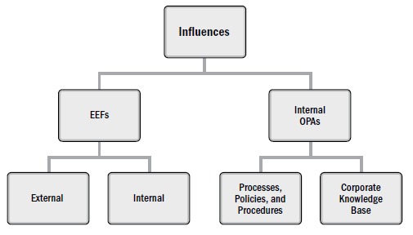
The Environment in which Projects Operate
Environment may have influence on each project
Two major categories of influences are
  enterprise environmental factors (EEFs): originate from the environment outside of the project and often outside of the enterprise. may have an impact at the organizational, portfolio, program, or project level. (i.e. different time zones, government regulations, organizational culture)
  organizational process assets (OPAs): internal to the organization. These may arise from the organization itself, a portfolio, a program, another project, or a combination of these. (i.e. company knowledge base, standards and procedures)

Slide 3
Enterprise Environmental Factors
Examples of internal EEFs:
Existing infrastructure: Availability of company servers, networks, tools.
Internal policies and procedures: Company-mandated security policies or work-from-home policies.
Resource availability: Limited in-house skilled developers.
Organizational culture or structure: A project in a highly bureaucratic organization may take longer to get approvals compared to one in a startup.

Slide 4
Enterprise Environmental Factors
Examples of External EEFs:
Marketplace conditions: If there's a global chip shortage, a hardware project may get delayed due to unavailability of components.
Social and cultural influences and issues: cultural norms may influence working hours during Ramadan.
Legal restrictions: An e-commerce project must implement data encryption and access controls to comply with PCI DSS legal requirements for handling credit card transactions..
Government or industry standards: A software development project must comply with the General Data Protection Regulation (GDPR) if handling European user data.
Political climate or economic trends: A construction project may pause or scale down due to an economic recession..

Slide 5
Organizational Process Assets
OPAs include any artifact, practice, or knowledge from any or all the performing organizations involved in the project that can be used to execute or govern the project.
They may be grouped into two categories:
  Processes, policies, and procedures
    Project management methodology used by the organization (e.g., Agile, Waterfall)
    Change control procedures
    Coding standards or QA processes
    Risk management policies
    Procurement processes and templates
  Organizational knowledge bases
    Lessons learned database from past projects
    Project archives (schedules, budgets, performance data)
    Knowledge-sharing platforms or wikis
    Historical cost and effort estimates

Slide 6
Organizational Structure
Factors to consider in selecting an organizational structure include but are not limited to:
  Degree of alignment with organizational objectives
  Clear path for escalation of decisions
  Clear line and scope of authority
  Delegation capabilities
  Accountability assignment
  Responsibility assignment
  Efficiency of performance
  Physical locations (e.g., co-located, regional, and virtual), and
  Clear communication (e.g., policies, status of work, and organization’s vision).

Slide 7
Organizational Structure
Organizational structures take many forms or types
  Organic or Simple
  Functional (centralized)
  Multi-divisional (may replicate functions for each division with little centralization)
  Matrix – strong
  Matrix – weak
  Matrix – balanced
  Project-oriented (composite, hybrid)
  Hybrid
  PMO (Project Management Office)

Slide 8
Organizational Structure
Organic or Simple
  Work Groups Arranged by: people working side-by-side
  Project Manager’s Authority : Little or none
  Project Manager’s Role : Part-time; may or may not be a designated job role like coordinator
  Resource Availability : Little or none
  Who Manages the Project Budget? : Owner
  Project Management Administrative Staff : Little or none

Slide 9
Organizational Structure
Functional (centralized)
  Work Groups Arranged by: Job being done (e.g., engineering, manufacturing)
  Project Manager’s Authority : Little or none
  Project Manager’s Role : Part-time; may or may not be a designated job role like coordinator
  Resource Availability : Little or none
  Who Manages the Project Budget? : Functional manager
  Project Management Administrative Staff : Part-time

Slide 10
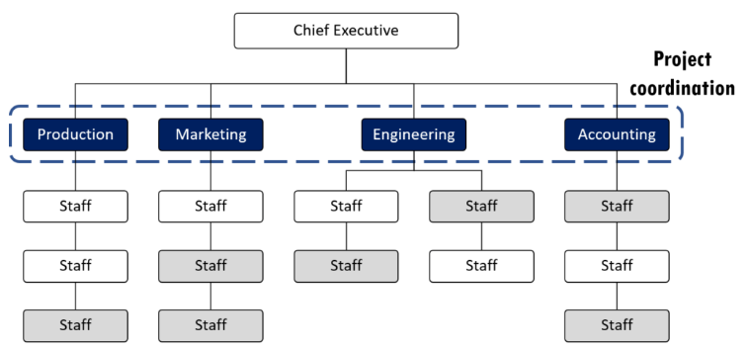
Organizational Structure
Functional

Slide 11
Organizational Structure
Multi-divisional (may replicate functions for each division with little centralization)
  Work Groups Arranged by: One of product, production processes, portfolio, program, geographic region, customer type
  Project Manager’s Authority : Little or none
  Project Manager’s Role : Part-time; may or may not be a designated job role like coordinator
  Resource Availability : Little or none
  Who Manages the Project Budget? : Functional manager
  Project Management Administrative Staff : Part-time

Slide 12
Organizational Structure
Matrix – strong
  Work Groups Arranged by: By job function, with project manager as a function
  Project Manager’s Authority : Moderate or High
  Project Manager’s Role : Full-time designated job role
  Resource Availability : Moderate or High
  Who Manages the Project Budget? : Project manager
  Project Management Administrative Staff : Full-time

Slide 13
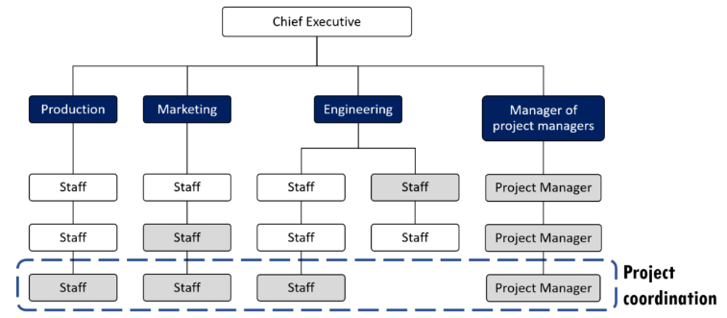
Organizational Structure
Matrix – strong

Slide 14
Organizational Structure
Matrix – Weak
  Work Groups Arranged by: By job function
  Project Manager’s Authority : Low
  Project Manager’s Role : Part-time; done as part of another job and not a designated job role like coordinator
  Resource Availability : Low
  Who Manages the Project Budget? : Functional manager
  Project Management Administrative Staff : Part-time

Slide 15
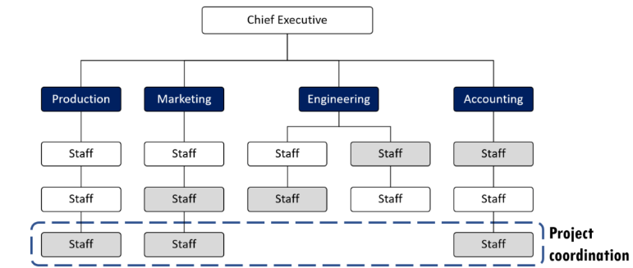
Organizational Structure
Matrix – weak

Slide 16
Organizational Structure
Matrix – Balanced
  Work Groups Arranged by: By job function
  Project Manager’s Authority : Low or Moderate
  Project Manager’s Role : Part-time; done as part of another job and not a designated job role like coordinator
  Resource Availability : Low or Moderate
  Who Manages the Project Budget? : Mixed
  Project Management Administrative Staff : part-time

Slide 17
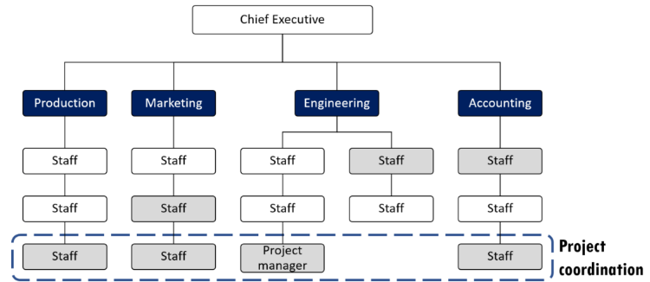
Organizational Structure
Matrix – balanced

Slide 18
Organizational Structure
Project-oriented (composite, hybrid)
  Work Groups Arranged by: Project
  Project Manager’s Authority : High to almost total
  Project Manager’s Role : Full-time designated job role
  Resource Availability : High to almost total
  Who Manages the Project Budget? : Project manager
  Project Management Administrative Staff : Full-time

Slide 19
Organizational Structure
Hybrid
  Work Groups Arranged by: Mix of other types
  Project Manager’s Authority : Mixed
  Project Manager’s Role : Mixed
  Resource Availability : Mixed
  Who Manages the Project Budget? : Mixed
  Project Management Administrative Staff : Mixed

Slide 20
Organizational Structure
PMO (Project Management office)
  Work Groups Arranged by: Mix of other types
  Project Manager’s Authority : High to almost total
  Project Manager’s Role : Full-time designated job role
  Resource Availability : High to almost total
  Who Manages the Project Budget? : Project Manager
  Project Management Administrative Staff : Full - Time

Slide 21
Project Management Office
    PMO is an organizational structure that standardizes project governance and shares resources, tools, and methodologies.
    Key Responsibilities of a PMO:
      Manage shared resources across projects
      Develop and implement project management standards and best practices
      Provide coaching, mentoring, and training
      Monitor compliance with project management policies
      Manage project documentation and templates
      Coordinate communication across projects

Slide 22
Project Management Office
    types of PMOs in organizations:
Supportive
Provides tools, templates, and guidance.
  Example: Offers training sessions and project documentation templates.
The degree of control provided by the PMO is low.
PMO
Controlling
provides support and requires compliance through various means.
  Example: Reviews project plans to ensure they follow company guidelines.
The degree of control provided by the PMO is moderate
Compliance may involve:
  Adoption of project management frameworks or methodologies,
  Use of specific templates, forms, and tools…
Directive
Directly manages projects and teams.
Project managers are assigned by and report to the PMO.
  Example: Takes full control of project execution and resource allocation.
The degree of control provided by the PMO is high.

Slide 23
Comparison Table
Structure Type | Work Group Arrangement | PM Authority | PM Role | Resource Availability | Budget Managed By | PM Admin Staff
Organic / Simple | Side-by-side (informal) | Little / None | Part-time (may vary) | Little / None | Owner | Little / None
Functional | By job function (e.g., engineering, sales) | Little / None | Part-time (coordinator) | Little / None | Functional Manager | Part-time
Multi-divisional | By product/region/customer type | Little / None | Part-time | Little / None | Functional Manager | Part-time
Matrix – Weak | By job function | Low | Part-time (non-role) | Low | Functional Manager | Part-time
Matrix – Balanced | By job function | Low / Moderate | Part-time (non-role) | Low / Moderate | Mixed | Part-time
Matrix – Strong | By job + project (PM is a function) | Moderate / High | Full-time | Moderate / High | Project Manager | Full-time
Project-Oriented | By project | High / Total | Full-time | High / Total | Project Manager | Full-time
Hybrid | Mix of multiple types | Mixed | Mixed | Mixed | Mixed | Mixed
PMO (Project Mgmt Office) | Mix (PMO governs projects) | High / Total | Full-time | High / Total | Project Manager | Full-time

Slide 24
Comparison Table
    Ask these questions:
      Who controls the team and budget? (PM or functional manager?)
      Is the PM full-time or just coordinating part-time?
      Are resources dedicated or shared?
      Are we organized by function, project, region, etc.?

Slide 25

Think Yourself..
You are the Project Managers of XYZ consultants. The Project team members are from Finance and HR departments. The team members report to Finance and HR Managers respectively, and you have limited control over them. What type of organizational structure does XYZ consultants follow?

Slide 26
Think Yourself..
A project manager is trying to complete a SW development project, but can not get enough attention for the project. Resources are focused on completing process-related work and the PM has little authority to properly assign resources. What form of organization must the PM be working in?

Slide 27

Role of a Project Manager (PM)
Conductor who directs the performance with movements of the hands and arms, often made easier for the musicians

Slide 28
Role of a Project Manager (PM)
Membership and roles:
A large project and an orchestra each comprise many members, each playing a different role.
A large orchestra may have more than 100 musicians who are led by a conductor.
These musicians may play 25 different kinds of instruments
Similarly, a large project may have more than 100+ project members led by a project manager.
Team members may fulfill many different roles, such as design, manufacturing, and facilities management.

Slide 29
Role of a Project Manager (PM)
Responsibility for team:
Shared Responsibility: Both the project manager and conductor are responsible for the team's output.
Holistic Approach: They work together to plan, coordinate, and complete the team's tasks.
Vision & Objectives: The leaders define the vision, mission, and objectives for successful completion.
Communication & Motivation: They use their interpretation to motivate and guide the team towards success.

Slide 30
Role of a Project Manager (PM)
Knowledge and skills:
Doesn't need to perform every project role but must have project management and technical knowledge
Leads through planning, coordination, and clear communication (written plans, schedules, meetings, and verbal/nonverbal cues).

Slide 31
Role of a Project Manager (PM)
Responsible and accountable:
Make sure the project is completed within Schedule and within budget
Determine and deliver required level of quality
Select Appropriate process for the project
Identifies and analyses constrains and assumptions
Leads and directs project planning effort
Identifies dependencies between activities
Assist project team during execution
Reports Project progress on time
Project Manager is accountable for project success or failure

Slide 32
Project Manager (PM)
The project manager is the person assigned by the performing organization to lead the team that is responsible for achieving the project objectives.
How the project manager differ from functional or operational manager?
The functional manager focuses on providing management oversight for a functional or business unit. Operations managers are responsible for ensuring that business operations are efficient.

Slide 33
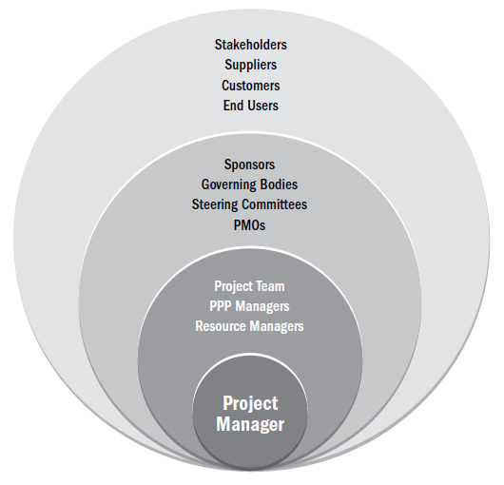
Project Manager’s Sphere of Influence

Slide 34
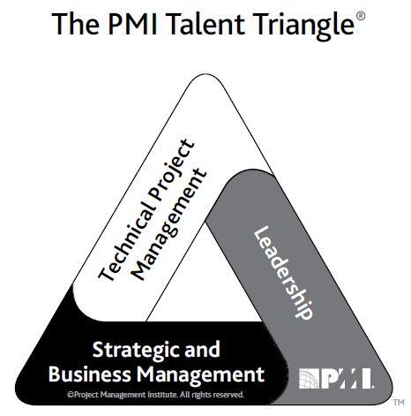
Project Manager Competency
Technical project management. The knowledge, skills, and behaviors related to specific domains of project, program, and portfolio management. The technical aspects of performing one’s role.
Leadership. The knowledge, skills, and behaviors needed to guide, motivate, and direct a team, to help an organization achieve its business goals.
Strategic and business management. The knowledge of and expertise in the industry and organization that
enhanced performance and better delivers business outcomes.

Slide 35
Leadership
Project managers may lead their teams in many ways. (LOTE)
The leadership style a project manager selects may be a personal preference, or the result of the combination of multiple factors associated with the project.
  Leader characteristics (e.g., attitudes, moods, needs, values, ethics);
  Team member characteristics (e.g., attitudes, moods, needs, values, ethics);
  Organizational characteristics (e.g., its purpose, structure, and type of work performed); and
  Environmental characteristics (e.g., social situation, economic state, and political elements).

Slide 36
Leadership Styles
Laissez-faire (e.g., allowing the team to make their own decisions and establish their own goals, also referred to as taking a hands-off style);
Transactional (e.g., focus on goals, feedback, and accomplishment to determine rewards; management by exception);
Servant leader (e.g., demonstrates a commitment to serve and put other people first; focuses on other people’s growth, learning, development, autonomy, and well-being; concentrates on relationships, community and collaboration; leadership is secondary and emerges after service);
Transformational (e.g., empowering followers through idealized attributes and behaviors, inspirational motivation, encouragement for innovation and creativity, and individual consideration);
Charismatic (e.g., able to inspire; is high-energy, enthusiastic, self-confident; holds strong convictions);

Slide 37
Leadership Styles
Transformational
Charismatic
Jeff Bezos is the most famous example of a transformational leader. Like many companies, Amazon operates under the instruction that the customer is king, so Bezos and his team dedicated their first year of business to generating customer reviews, a practice that was unheard of in e-commerce at the time.
Steve Jobs is a great example. When he returned to Apple in 1997 as the chief executive officer, the company was nearly bankrupt, but he made several big changes fast. He:
Convinced Microsoft to invest $150m
Cut the number of Apple products by 70%
Cut around 3,000 jobs
This led to an unbelievable $309m profit the following year.

Slide 38

Personality

Slide 39
Personality
    Personality refers to the individual differences in characteristic patterns of thinking, feeling, and behaving.
Personality characteristics or traits include but are not limited to:
Authentic (e.g., accepts others for what and who they are, show open concern);
Courteous (e.g., ability to apply appropriate behavior and etiquette);
Creative (e.g., ability to think abstractly, to see things differently, to innovate);
Cultural (e.g., measure of sensitivity to other cultures including values, norms, and beliefs);
Emotional (e.g., ability to perceive emotions and the information they present and to manage them; measure of interpersonal skills);
Intellectual (e.g., measure of human intelligence over multiple aptitudes);
Managerial (e.g., measure of management practice and potential);
Political (e.g., measure of political intelligence and making things happen);
Service-oriented (e.g., evidence of willingness to serve other people);
Social (e.g., ability to understand and manage people); and
Systemic (e.g., drive to understand and build systems).

Slide 40
“leadership” and “personality” are synonymous, do you agree?

Slide 41
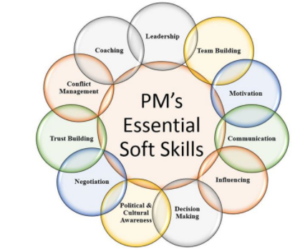
PM’s Soft skills

